Slide 1
Microsoft Digital Marketing Content OnDemand (DMC)
aka.ms/DMC
Microsoft
Cloud Partner Program

Slide 2
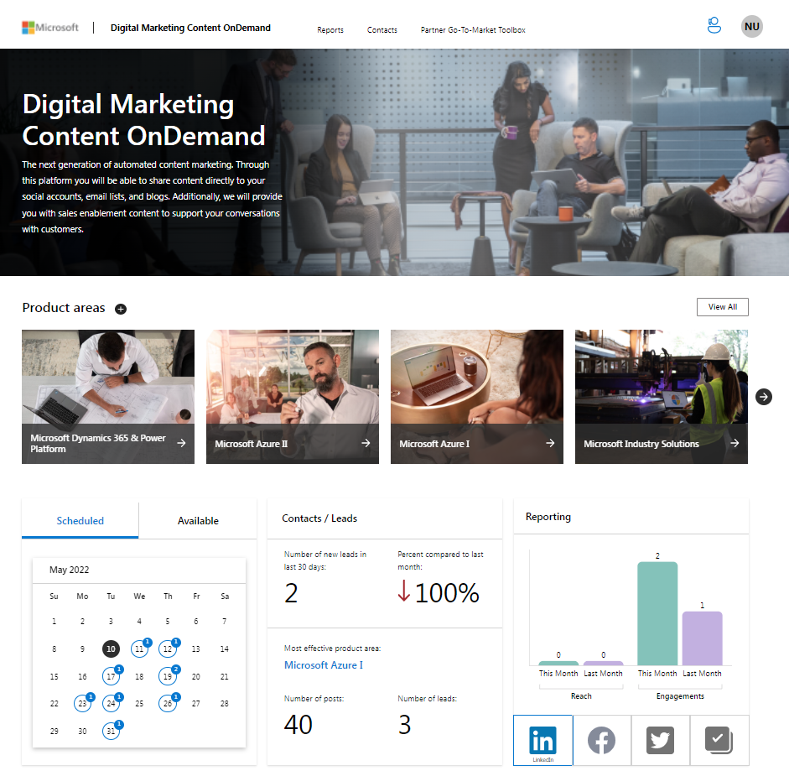
Microsoft Digital Marketing Content OnDemand
What is Digital Marketing Content OnDemand?
This simple, easy-to-use tool provides partners with comprehensive digital campaigns that include curated, to-customer marketing materials and sales resources in a highly prescriptive format. Suggested tweets, LinkedIn posts, Facebook statuses, mini-blog posts, and emails are provided (yet fully customizable), and with intelligent technology—partners’ logos and company names are automatically inserted to customize the content.
Benefits:
Benefit 1: Build and optimize digital marketing strategy and approach with digital campaigns that include both to-customer and to-partner resources
Benefit 2: Increase demand generation by connecting with customers and prospects by harnessing the power of social media and email to share both Microsoft generated campaigns, as well as your own
Benefit 3: Capture and close leads through gated content
Which partners is this resource ideal for?
Available to all Microsoft Partners at aka.ms/dmc.

Slide 3
Pain points we’ve heard from partners
Locating the right Microsoft content
Pulling together cohesive campaigns
Managing multiple social media accounts
Tracking ROI on social media
Partners report spending 3-8 hours/week on average looking for content
Finding the right content and creating a campaign requires more time or resources than partners report having
Consistency is the key to social media and partners report not having time to keep their blogs or social accounts active
Partners have no way to track customer interactions with content or content ROI
“
[Digital Marketing Content OnDemand] makes my job so much easier to have everything automated. It increases website traffic, shows our legitimacy as a company, and provides more awareness for my sales team to talk about Microsoft solutions. My sales reps can now speak to customers about multiple solutions at the same time and feel confident in their knowledge.”
- Channel partner
I am very grateful for the [Digital Marketing Content OnDemand] content each week! Thank you! It saves me time and marketing dollars, and it is high quality.”
– Channel Partner
Notes:
Partners have told us that they need an easy, fast way to search and include content for target audiences.
Locating the right Microsoft content for our customer needs
Partners need help to navigate, search and use the valuable and up-to-date Microsoft Partner Network content to accelerate sales
Quickly building customer content and sales proposals
Your resources should be focused on new business and growing revenue, not curating and repackaging Microsoft content
Getting content to market faster
That might mean getting content to your sales team, partners, or customers faster
Partners want to improve time to market and sales velocity of customer deals
In addition, they want to be able to save content for re-use
Knowing what content is used and how effective it is
Microsoft and partners want to give your salesforce what they need, understand usage and value of content, and continue to improve the partner experience

Slide 4
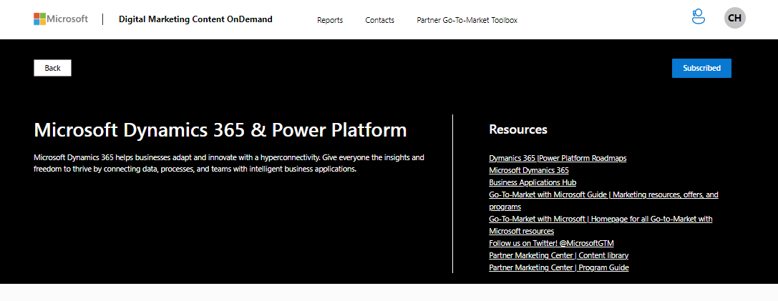
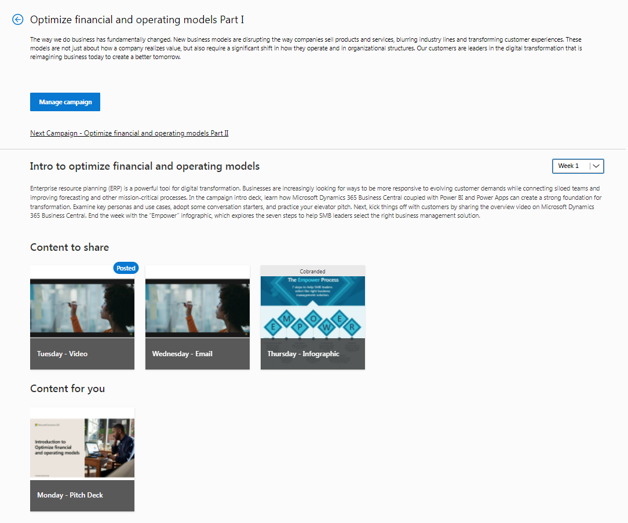
Why we’re here
Next generation automated content marketing!
Build and optimize your digital marketing strategy and approach with automated marketing
Share comprehensive digital campaigns complete with to-customer content complete with prewritten tweets, LinkedIn posts, Facebook statuses, mini-blog posts, and emails—all of which are fully customizable
Easily access sales enablement and training assets complete with prescriptive guidance
Post to social media accounts and launch email campaigns from directly within the platform
Maintain a consistent social marketing presence, regardless of time to spend on marketing, by using the auto-update feature
“
“Just wanted to share good stats on our LinkedIn company page due to the awesome content from Microsoft [Digital Marketing Content OnDemand]. In the last 30 days. We’ve had 424 visitors to our page (up 41%), our posts generated 16,400 impressions, and we’ve added 27 new followers (up 200%).
– Channel Partner
Notes:
We’re here today to:
Introduce and launch a new Microsoft Partner Network sponsored program.
This program can enable your sales force by streamlining access to partner network content.
It also lets you scale this opportunity to downstream partners.
We’re beginning this program with offices in Canada and then we plan to roll it out worldwide.
This program builds on the success of the completed U.S. pilot.
We want to tell you why we’re launching this program and more about what it is.
Next we’ll do a demo of the solution.
Then we’ll dive into how you might use this solution within your organization.
And we’ll wrap up with how you can take part in the program and what the next steps are.

Slide 5
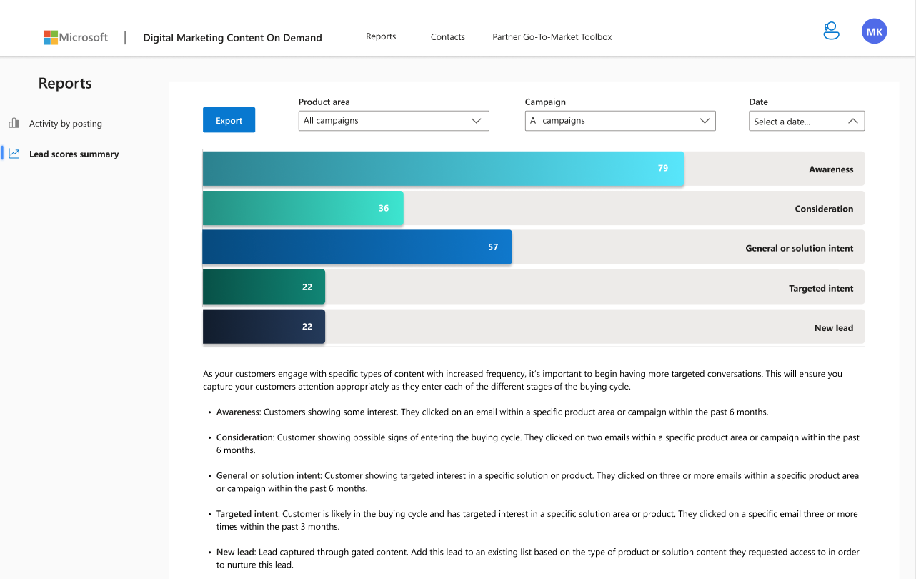
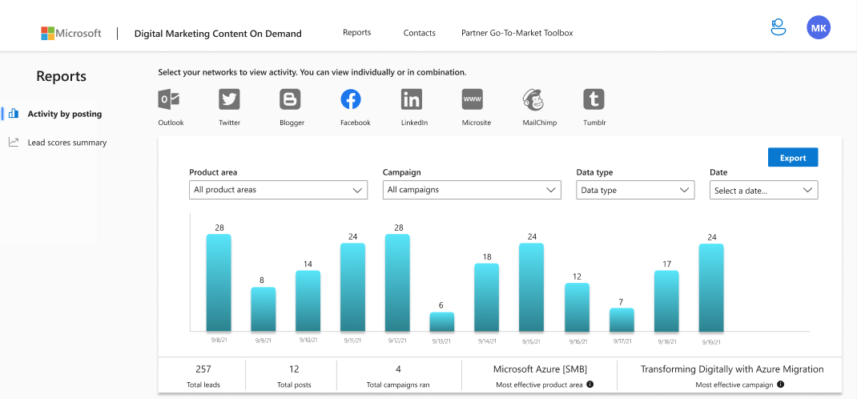
Don’t forget to analyze your data!
High-level reports are available on the main dashboard, including your most effective product area, number of posts, number of new leads, and reach/engagement across your social accounts.
You can take a deeper dive into your data through “Activity by posting” and “Lead score summary” reports. We include clear and actionable guidance to help you understand when to have more targeted conversations as your current customers enter a new buying cycle.
Notes:
Value to your sales & marketing teams:
Shorten sales cycles and improve win rates
Make it easy to incorporate MPN content into your sales and marketing process
Become a trusted source as a conduit to powerful Microsoft content
Track what content is being used and how it’s used
Reach more customers, more effectively
Value to your partners:
Improve their sales velocity through better, up to date content
Improve marketing content value and impact
Easily locate and personalize the best sales and marketing content for their target audience
Reduce the proposal team’s effort and improve wins
Focus valuable sales rep time on new business - not searching

Slide 6
Next steps
Sign up today at aka.ms/dmc
Questions?
Contact the Digital Marketing Content OnDemand support team at DMCSup@microsoft.com.

Slide 7
Thank you.

