Slide 1

Partner Opportunities:
Microsoft Azure Virtual Desktop
Enable a secure remote desktop experience from virtually anywhere.

Slide 2

Customer demands impacting
service providers
Customers don’t have the skills to do what needs to be done.
Key skills shortages for decision makers skills that customers look to partners to fulfill:
Architecture
42%
DevOps
39%
Cloud architect
36%
Cloud management/orchestration
24%
Machine or deep learning
22%
Cloud-native programming
16%
Database administration
Operations
43%
Cloud platform expertise
25%
Software-defined networking
21%
Cloud server/system administration
70%
20%
Cloud storage administration
19%
Cloud provider management
13%
OpenStack
of customers in cloud
use a provider to either build or maintain their multi-cloud environments.*
Security
43%
Cloud provider management
23%
OpenStack
*2018, IDC, When Computing Becomes Human: Automation, Innovation and the Rise of the All-Powerful Service Provider

Slide 3

Opportunities by partner type
Value-Added Services Provider (ISVs)
Service model
Extend apps and additional functionalities on top of Azure Virtual Desktop to end customers.
GTM/Licensing
License offers to end customers through Azure Marketplace.
Learn how to promote your application and services on Azure Marketplace.
Programs/Support
Azure Everywhere, ECIF, FastTrack for Azure, Azure for technology partners

Slide 4

Opportunities by partner type
Desktop as a Service Provider (Hosting Partners, SIs)
Service model
Provide fully managed virtual desktops (DaaS) and apps through Azure Virtual Desktop.
GTM/Licensing
Desktop as a Service and related services through Cloud Solution Provider (CSP) program.
Learn how to become a CSP Provider.
Programs/Support
Azure: Azure Everywhere, Azure Deployment offers, ECIF, Advanced
Specialization, AMMP, Azure Immersion Workshop, Exam AZ-140

Slide 5
Business Opportunities
Increase margins and customer value while lowering costs when you help customers move from on premises virtualization to Azure Virtual Desktop.
Increase
Decrease
Partner margin and incentive rates
Infrastructure costs
On Premises
Cloud
• Reduce CapEx moving infrastructure to Azure IaaS.
• Lower costs with standard environment.
16.5% Windows Server
16.25% RDS CAL
26% Windows/M365 E3
22% Azure Consumption
Partners
Customers
Customer value
Customer price
• Comprehensive offer supports Windows 11,
Windows 10, Windows Server, and Windows 7.
• Deliver full Windows 10/11 desktop capability.
Optimize costs by taking advantage of Reserved Instances and by using multi-session Windows 10.

Slide 6
Getting Started
Use the resources on this page to get access to Azure Virtual Desktop, learn about the product, and start engaging customers.
Azure
Microsoft 365
Azure Partner Resources
Azure Virtual Desktop news, conversations, and public preview information:
Modern use cases, news, and customer:
Customer facing marketing assets:
Azure Virtual Desktop on Azure.com (Public Preview access)
Click-through demos
Azure Virtual Desktop on Microsoft365.com
Azure Virtual Desktop and Windows 365 blog
  Azure partner page
  Azure Virtual Desktop partner resource catalog

Slide 7
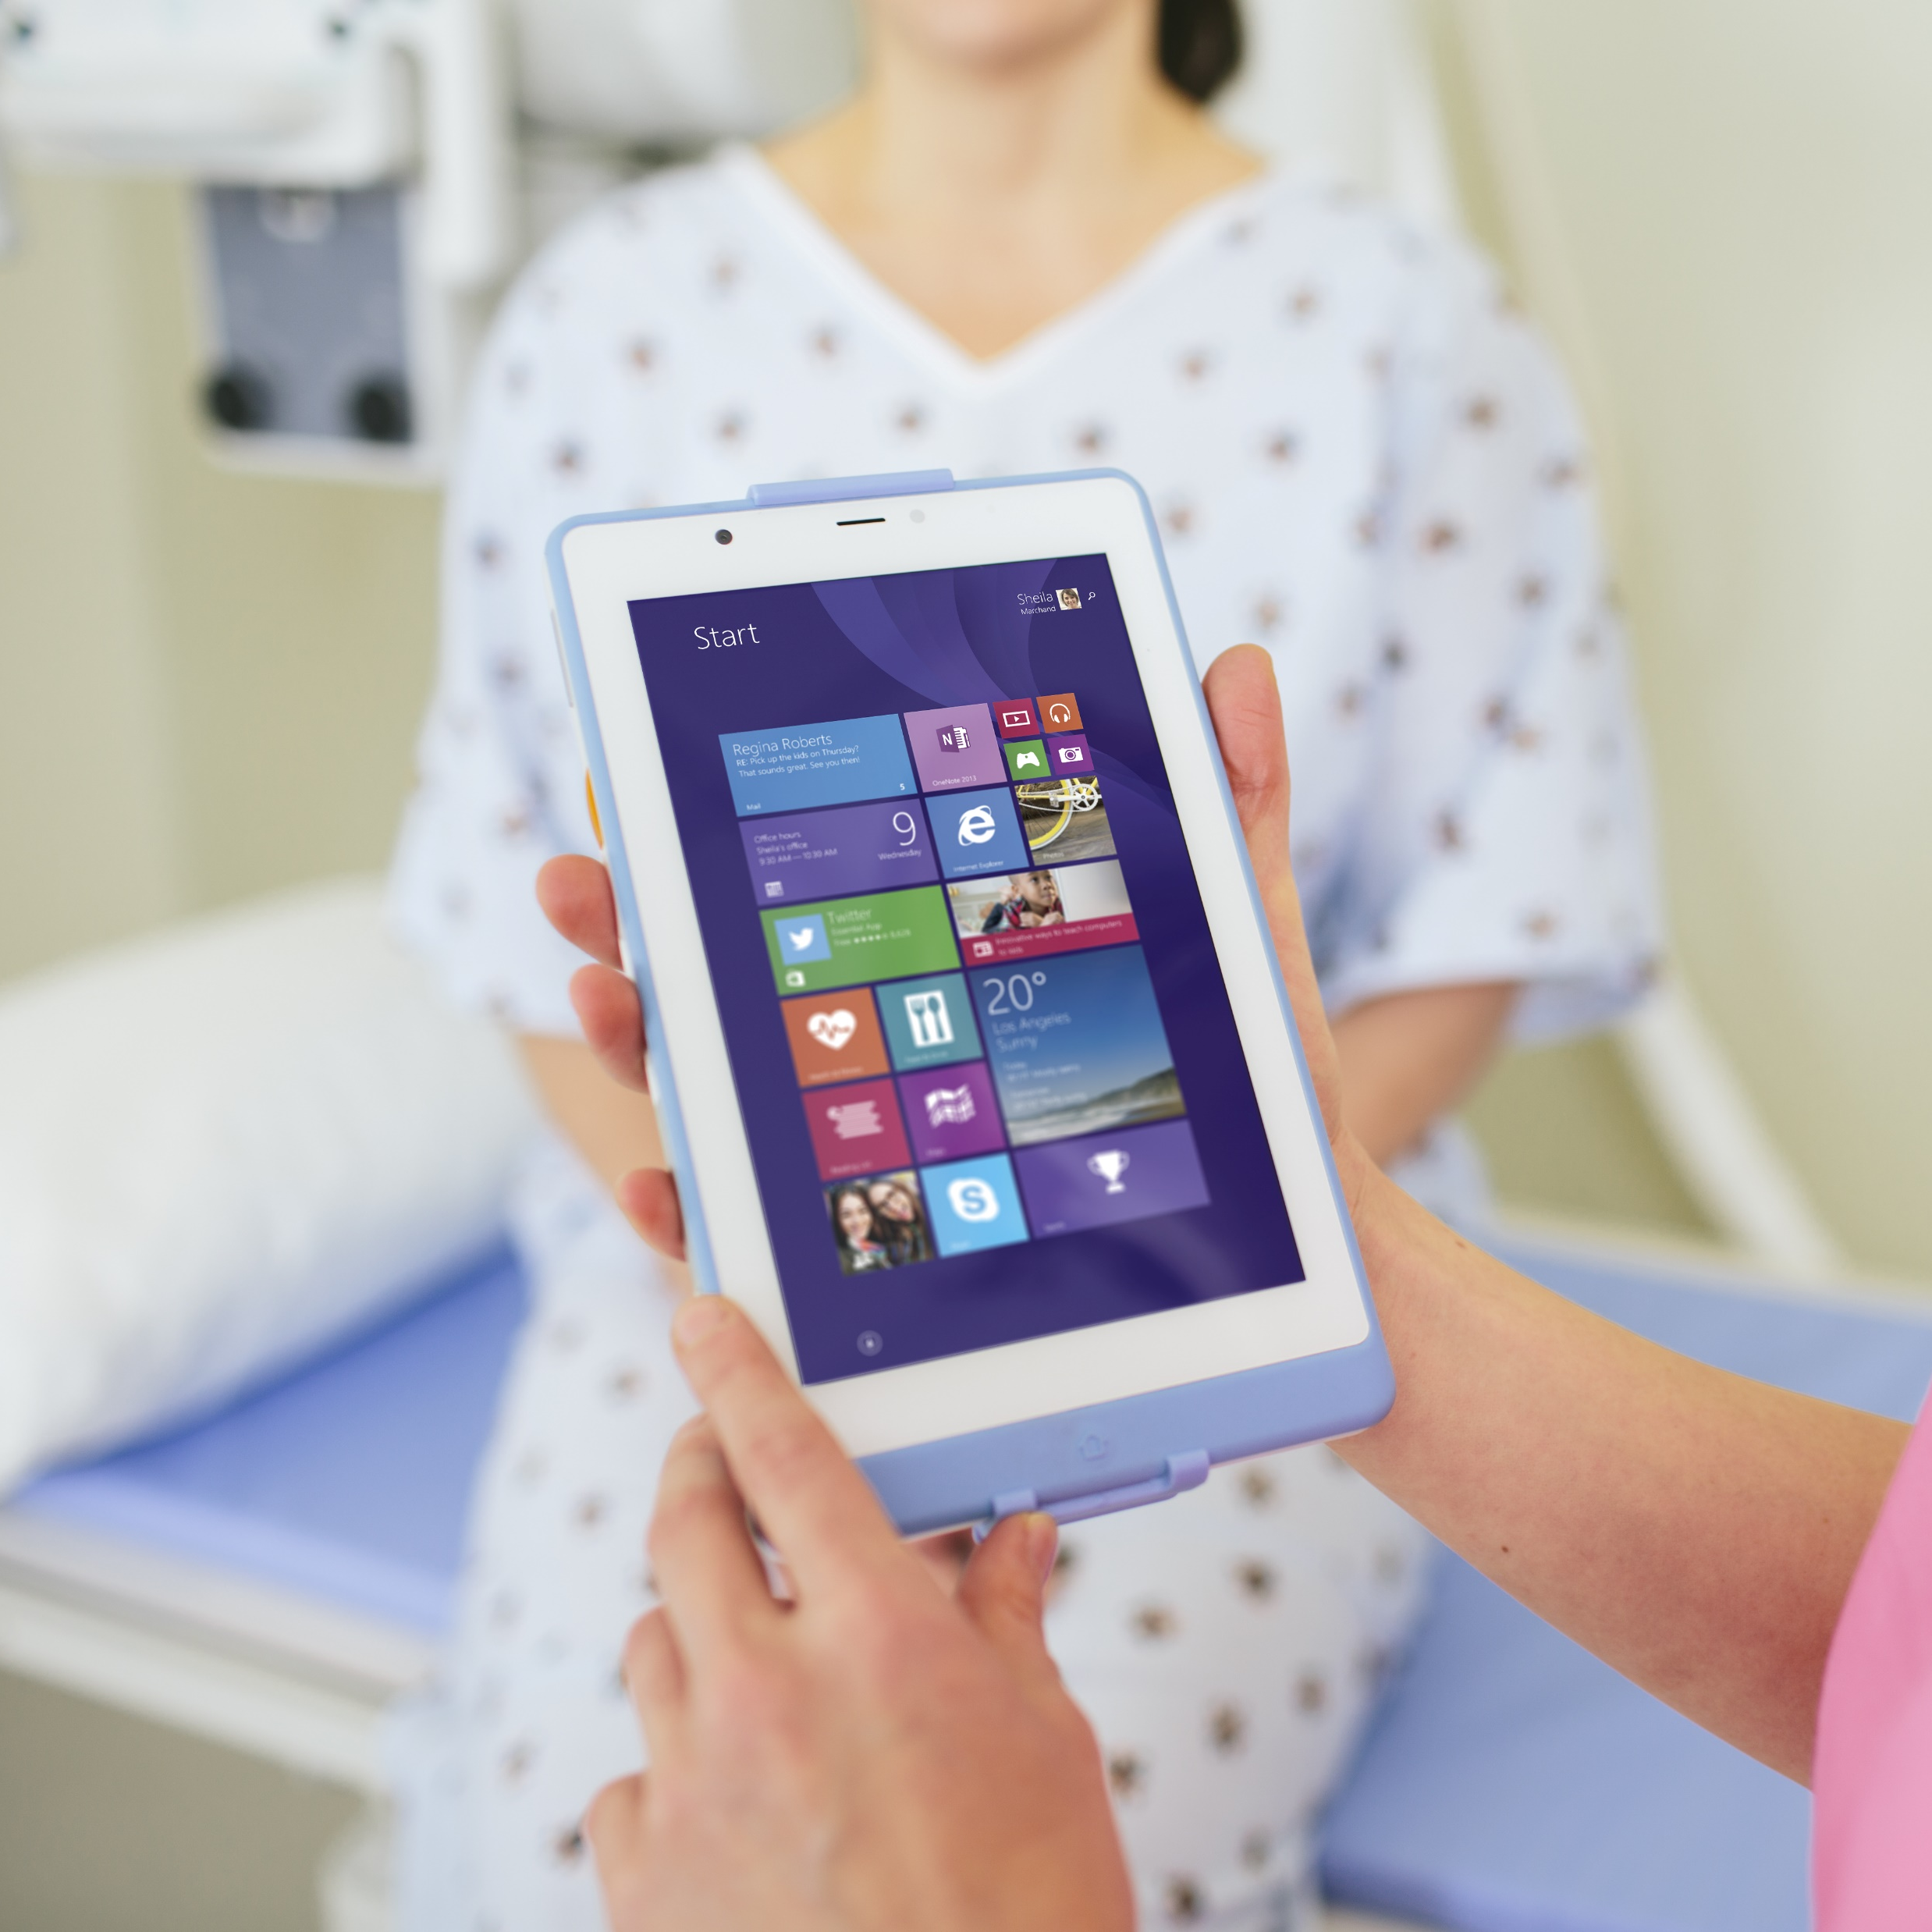
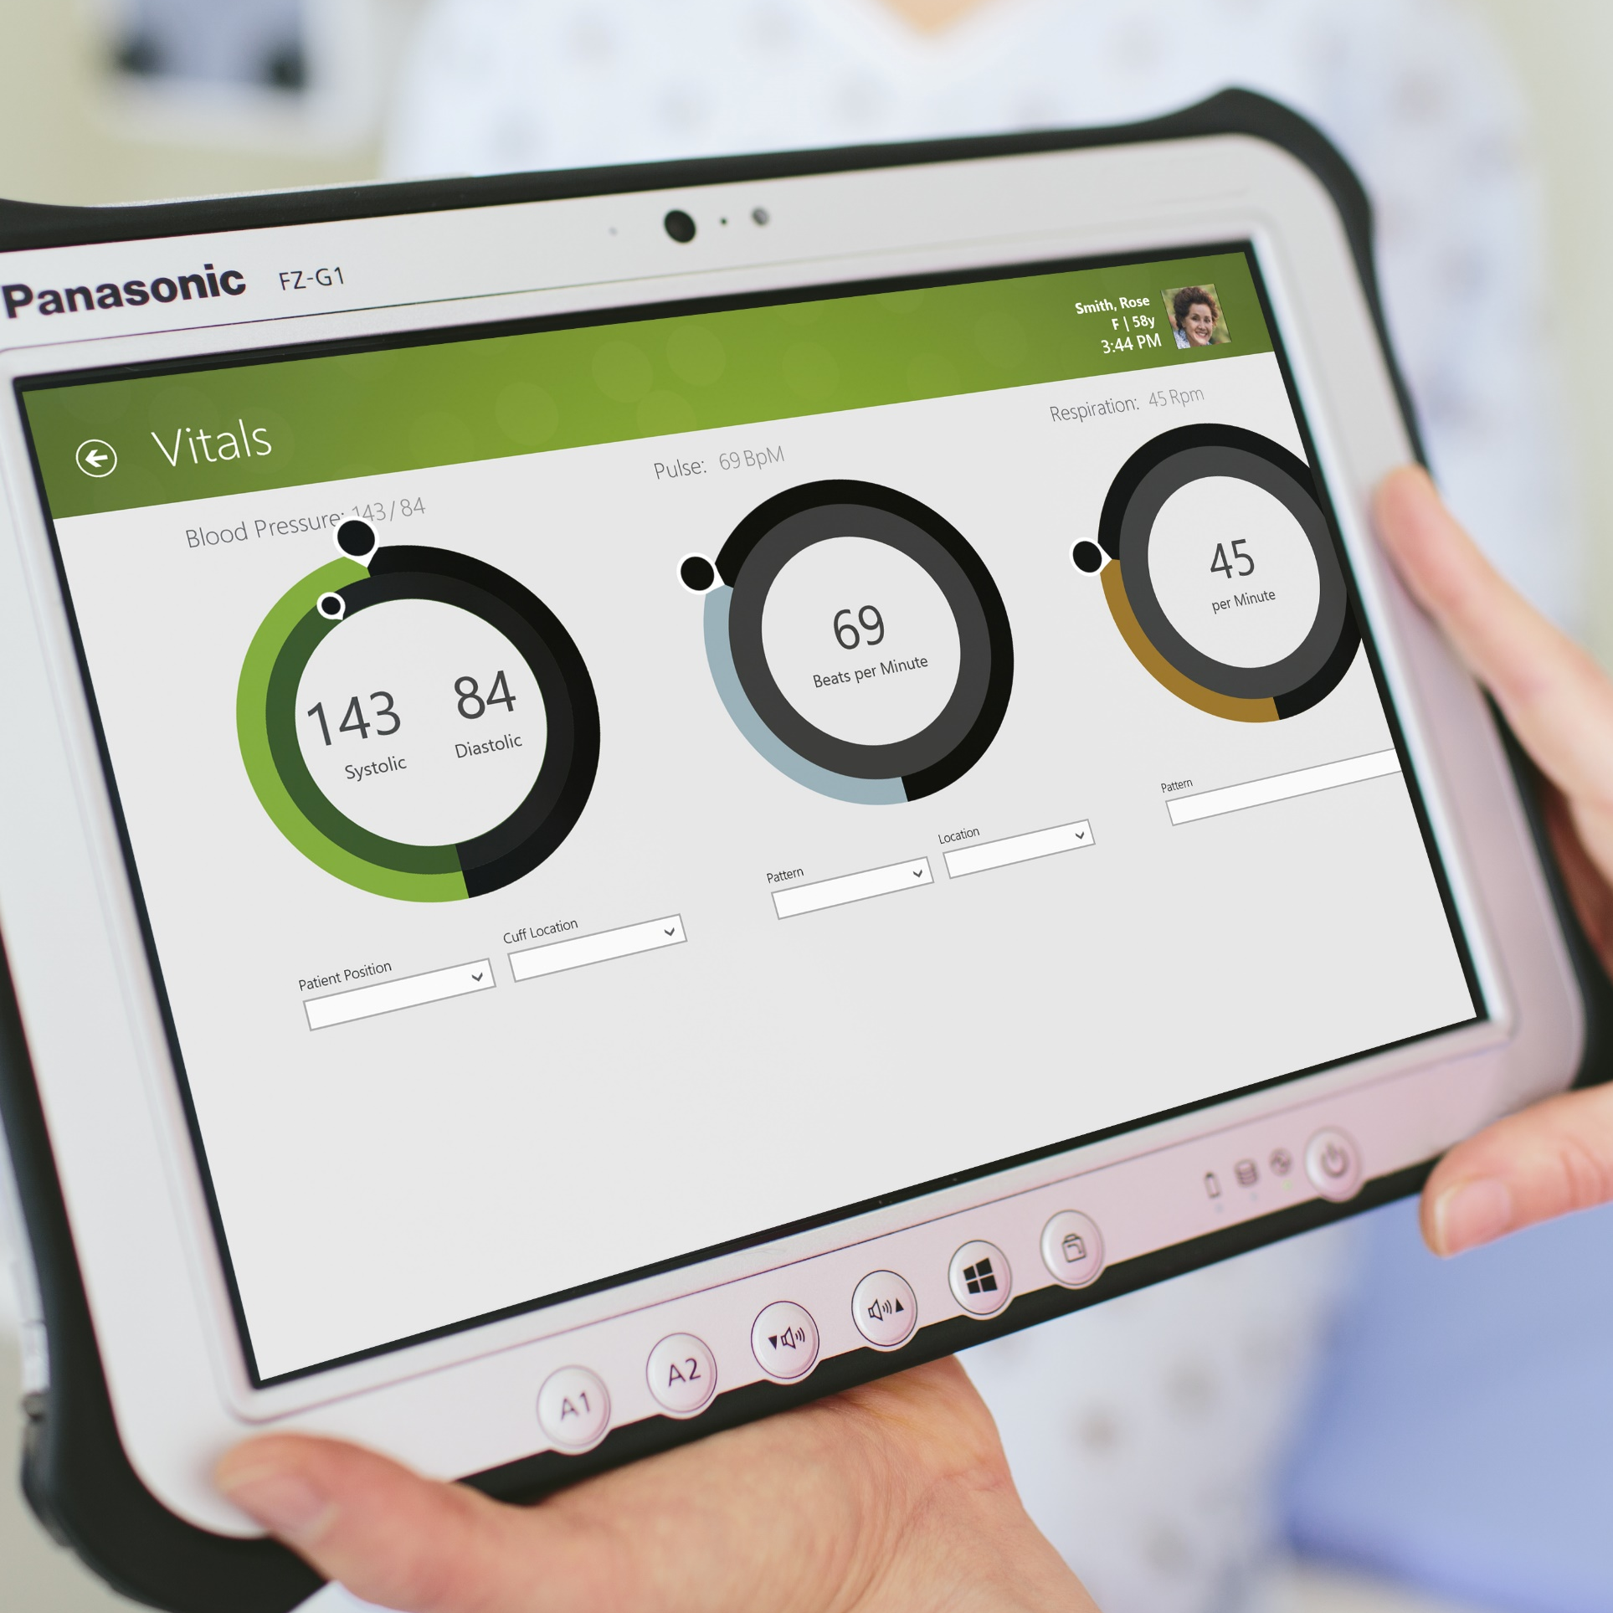
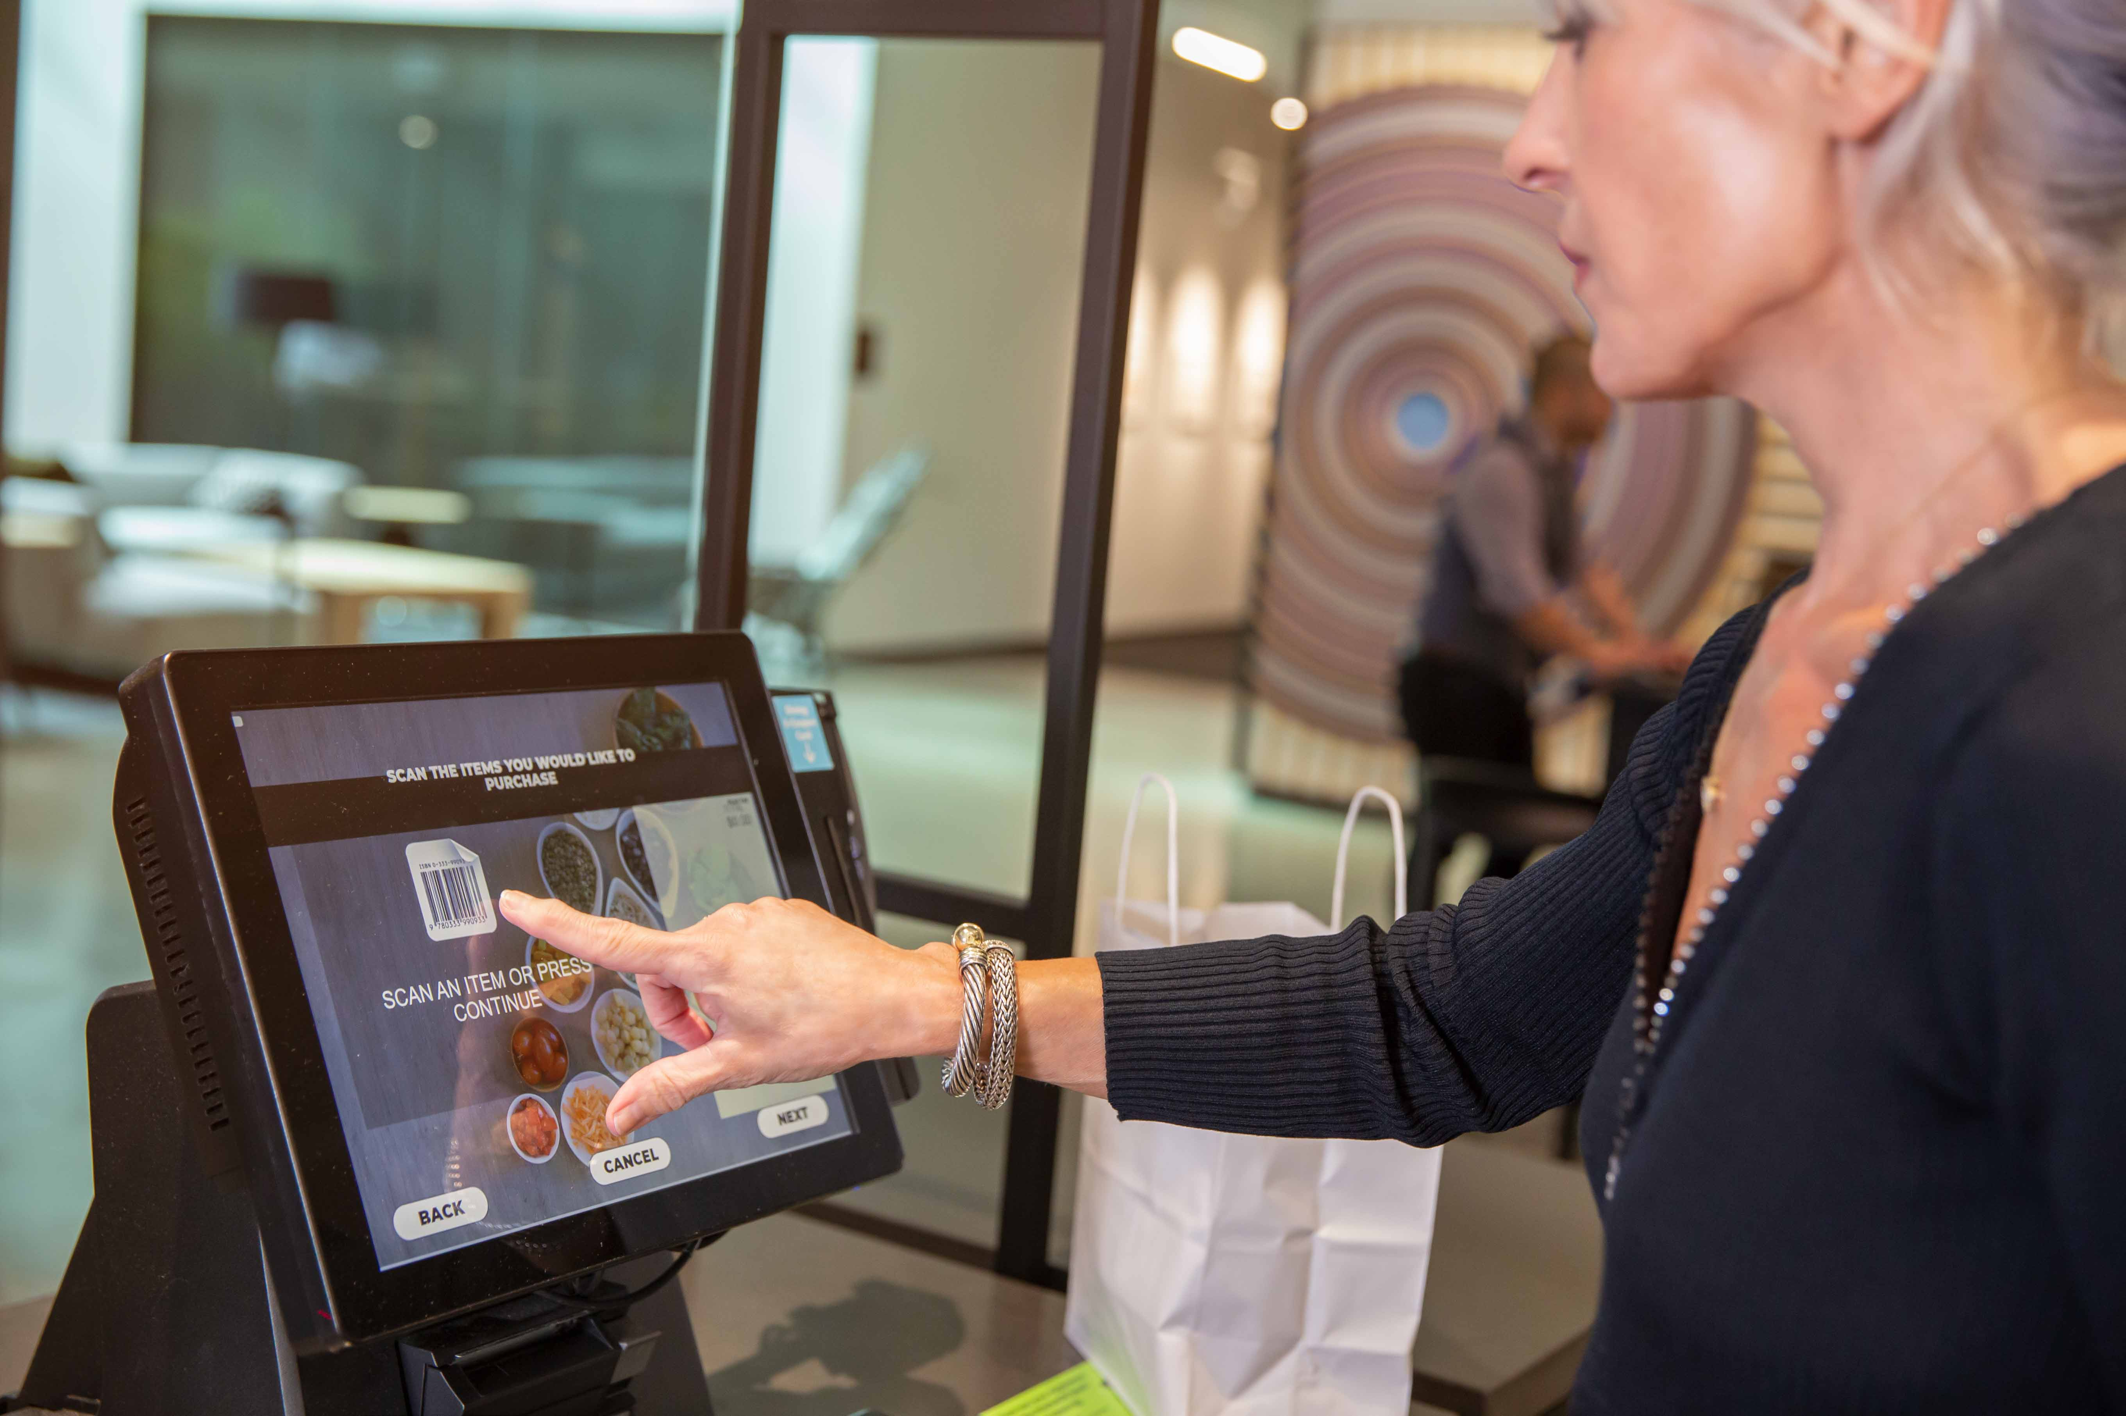

Virtualization helps address specific business needs
Security
and regulation
Elastic
workforce
Specific
employees
Specialized
workloads
Financial Services
Healthcare
Government
Mergers and acquisition
Short term employees
Contractor and partner access
BYOD and mobile
Call centers
Branch workers
Design and engineering
Legacy apps
Software dev test
Notes:
Virtualization helps companies address specific business needs:
More secure access to data/organizational resources
Compliance with industry regulations (i.e. FSI, healthcare, government)
An increasingly elastic workforce (i.e. mergers/acquisitions, short-term employees, contractor/partner access)
Employee-specific needs (i.e. BYOD or mobile staff, call centers, branch workers)
Specialized workloads (i.e. design/engineering, legacy apps, software dev test)
Azure Virtual Desktop helps:
Employees stay as productive with a virtualized experience on a PC, phone, tablet, or browser as they are with a physical PC sitting right in front of them
Simplify management, provisioning, and access to corporate data and apps
Support customers as they migrate to the cloud
Reduce the costs and resources associated with managing on-premises infrastructure
Empower IT to transform the workplace

Slide 8

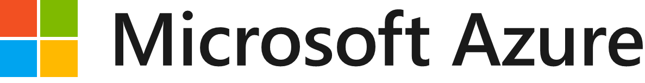




Azure Virtual Desktop – flexible cloud VDI platform
Quickly deploy virtual desktops and apps to enable secure remote work for a hybrid workplace.
Windows 10/11
+
Microsoft 365
Windows
Server
Deliver the only multi-session
Windows 10/11 experience.
Enable optimizations for
Microsoft 365 Apps for enterprise.
Stream apps to deliver SaaS solutions
to your employees and customers.
Deploy and scale in minutes.
Manage with 1st party, Citrix,
or VMware management solutions.
Notes:
Windows 10/11 and Office 365—kept up to date, with cloud-connected management powered by ConfigMgr and Intune—provides the most productive and most secure computing experience for users while lowering total cost of ownership and reducing complexity for IT teams
Designed for all customer types, across all segments, Microsoft 365 is the best way for customers to license the products and services necessary to deliver this experience.
Let’s take a look at each of these benefits, starting with productivity and what it means to have the most productive experience.

Slide 9

Deliver the only multi-session Windows 10/11 experience
Provide your users with the only multi-session Microsoft Windows 10 and Windows 11 experience virtualized in the cloud that’s highly scalable, always up to date, and available on any device.
Multi-session and single-session Windows 10/11.
Store and legacy app remoting.
Free Windows 7 extended security updates.

Slide 10

Enable optimizations for
Microsoft 365 Apps for enterprise
Deliver the best Microsoft 365 Apps for enterprise experience with multi-session virtual scenarios to provide the most productive virtualized experience to your users.
Office 365 containers make Office more performant in a multi-session environment—including Outlook and OneDrive for Business support.
Profile containers enable faster and more performant experience in
non-persistent environments.
A/V redirection enables you to use Microsoft Teams for video and audio
Notes:
Microsoft 365 Apps for enterprise, formerly Office 365 ProPlus--
Delivers a consistent Windows 10 and Office 365 experience for users across local and virtual workspaces:
New FSLogix technologies make Office 365 much more performant in multi-user virtual environments. (Outlook OST file, OneDrive cache, Windows Search DB and GAL)
FSLogix Profile Container enables full access to OneDrive, ability to run Outlook in cached mode; dramatically speeds up logon and application launch times
Office 365 optimized for multi-session virtualization deployments

Slide 11

Migrate existing Windows
Server (RDS) desktops and apps
Migrate your Remote Desktop Services (RDS) environment for Microsoft Windows Server desktops and apps with a simplified infrastructure management and deployment experience on Azure.
Support for Windows Server 2012 and Remote Desktop Services 2012R2 and newer.
App compatibility for existing Windows Server images used on-prem.

Slide 12
Deploy and scale in minutes
Quickly virtualize and deploy modern and legacy desktop app experiences in minutes with unified management in the Azure portal.
Azure has datacenters available
in 60+ regions and 140+ countries.
Azure management portal for Azure Virtual Desktop.
Built in security and compliance (Windows & Azure).
Partner ecosystem extensibility
(coming soon).

Slide 13
Azure Virtual Desktop
Full Windows 10/11 and Office 365 experience
Optimized for Microsoft 365 Apps for enterprise
Migrate your existing Windows Server (RDS) environment to Azure
Deploy and scale in minutes

Slide 14
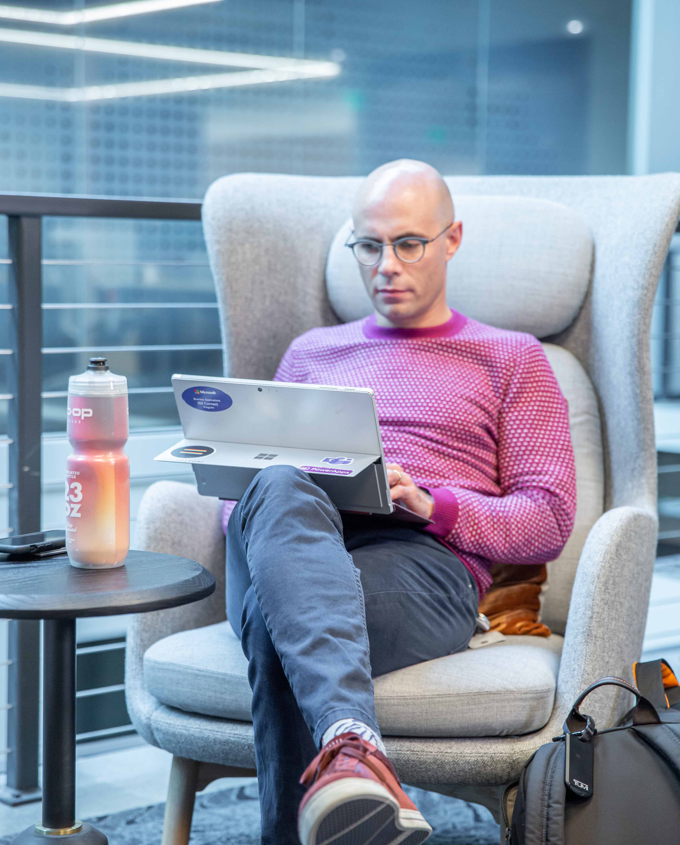
Additional benefits of
Azure Virtual Desktop
VDI/RDSH management as a service on Azure.
Most flexible service allowing you to virtualize both desktops and apps.
Windows 7 virtual desktop with free Extended Security Updates.
Integrated with the security and management of Microsoft 365.
Notes:
JUST DISCUSSED LIMITATIONS SERVER, TAKING BEST OF TWO.
WIN7 ESU, ONLY PAY FOR AZURE CONSUMPTION.
AZURE, SCALE IN MINUTES
FULL DESKTOP/APPS (other cloud providers don’t provide this)
CONDITIONAL ACCESS, INTUNE.
Lets take a look at the high level architecture.

Slide 15
High-level architecture
Utilizes Azure Active Directory identity management service.
Provides virtualization infrastructure as a managed service.
Deploy and manage VMs in Azure subscription.
Manage using existing tools like Configuration Manager or Microsoft Intune.
Simply connect to on-premise resources.
MANAGED BY MICROSOFT
Web access
Diagnostics
Gateway
Management
Broker
Load balancing
YOUR SUBSCRIPTION - YOUR CONTROL
Windows 7 Enterprise
Windows 10 Enterprise
Windows 10 Enterprise multi-session
Windows Server 2012
R2 and up
RemoteApp
MANAGED BY MICROSOFT
Compute
Storage
Networking
Notes:
THOSE FOLLOWED, RDmi. FEEDBACK SERVICE. BOXES
PROVIDE TOOLS
AAD
VM’s SUBSCRIPTION, VM’s OUTBOUND, NO 3389TCP
SUPPORT 7/10/SERVER, DESKTOP/APP

Slide 16
FSLogix Technologies
With the acquisition of FSLogix, eligible customers will get access to three core pieces of technology:
Profile Container
Replacement for roaming profiles and folder redirection. Dramatically speeds up logon and application launch times.
Includes Office 365 Container, which roams Office cache data (Outlook OST, OneDrive cache, Skype for Business GAL, etc.), and Windows Search DB with user in virtual desktop environments.
App Masking
Minimize number of gold images by creating a single image with all applications. Excellent app compatibility with no packaging, sequencing, backend infrastructure, or virtualization.
Java Redirection
Helps protect the enterprise from vulnerabilities of multiple installed versions of Java by mapping specific versions to individual apps or websites.

Slide 17

Many customers are already eligible for Azure Virtual Desktop
Azure Virtual Desktop Licensing Requirements
Client
Customers are eligible to access Windows 10 single and multi session and
Windows 7 with Azure Virtual Desktop if they have one of the following licenses*:
Microsoft 365 E3/E5
Microsoft 365 A3/A5/Student Use Benefits
Microsoft 365 F1
Microsoft 365 Business
Windows 10 Enterprise E3/E5
Windows 10 Education A3/A5
Windows 10 VDA per user
Server
Customers are eligible to access Server workloads with Azure Virtual Desktop if they have one of the following licenses:
RDS CAL license with active Software Assurance (SA)
Customers pay for the virtual machines (VMs), storage, and networking consumed when the users are using the service
*Customers can access Azure Virtual Desktop from their non-Windows Pro endpoints if they have a Microsoft 365 E3/E5/F1, Microsoft 365 A3/A5, or Windows 10 VDA per user license.
Notes:
KEY POINTS:
Many Microsoft customers are already eligible for Azure Virtual Desktop today…
This makes positioning Azure Virtual Desktop even easier

Slide 18
FSLogix entitlements
Access to FSLogix technology*
FSLogix technology, which improves the performance of Microsoft 365 Apps for enterprise in multi-user virtual environments, is now available at no additional cost for Microsoft 365 customers.
Microsoft 365 E3/E5/F1/Business
Microsoft 365 A3/A5/Student Use Benefits
Windows 10 Enterprise E3/E5
Windows 10 Education A3/A5
Windows 10 VDA per user
Remote Desktop Services (RDS) CAL
Remote Desktop Services (RDS) SAL
*Including Office 365 Container, Profile Container, App Masking, and Java Redirection

Slide 19

Pricing
Pay only for the virtual machines (VMs), storage, and networking consumed when your users are using the service.
You have the flexibility to pick any VM and storage options to match your use cases.
Take advantage of options such as one-year or three-year Azure Reserved Virtual Machine Instances, which can save you up to 72 percent versus pay-as-you-go pricing. Reserved Virtual Machine Instances are flexible and can easily be exchanged or returned.

Slide 20
NEW Per user access pricing for external users
We have introduced a new option for monthly per user pricing for purchasing access to Azure Virtual Desktop for external users only. Available starting July 14 – December 31, 2021.
+
  $5.50
  $10
  $0
  per user per month (Apps)
  per user per month (Apps + Desktops)
  if a user doesn’t connect to any Azure Virtual Desktop resources
Key points:
To stream a desktop, you need to include an application* with the desktop.
Includes only access rights to Azure Virtual Desktop first party solution.
Only provides access to Azure Virtual Desktop for external users of Win 7, Win10 or Win10 multi-session.
Provides access to up to 5 full desktops, any number of apps.
Supported discounts: Cloud Service Provider, Enterprise Agreement, Microsoft Azure Compute Cost, Reserved Instance.
To use integrated Office apps, Office licenses need to be purchased separately by the end user.
Cost of Azure infrastructure remains the same.
Paid through an Azure subscription.
Does not support AAD external/guest users.

Slide 21
Azure Virtual Desktop Partner ecosystem
Services partners with the Advanced specialization
Citrix partners approved for AMMP
VMware partners approved for AMMP
ISVs or Azure Virtual Desktop value-added partners
Azure Virtual Desktop hardware partners
Notes:
Infosys, DXC, Wipro, Cognizant, HCL, IBM.

Slide 22

When you combine the power of Citrix with
Azure Virtual Desktop, you can achieve so much more!
Step into
hybrid cloud
Turbo-charge Microsoft Teams
& Office 365
Modernize IT monitoring & security
Joint tools to simplify management and speed transition
Enable a hybrid cloud for virtual apps and desktops
Give users an intelligent experience
Give IT a modern approach to monitoring and control
Simply transition to cloud with seamless integration
Manage existing on-premises Citrix deployments alongside new Azure Virtual Desktops in Azure
Accelerate your Azure time to value
Centrally manage images, policies, and profiles
Use the same Citrix tools you already know and love
Take collaboration to the next level
Native Office 365, OneDrive,
and Teams app experience
Crystal-clear voice and video for Teams and Skype for Business
Overcome bandwidth limitations for branch or remote locations
Built-in intelligent capabilities aggregates actionable items, enhancing user productivity
Real-time policy engine adapts to changing access conditions – location, identity, device, and threats
Continues monitoring and real-time analytics respond before an incident occurs
Adaptive security and performance settings are automatically applied
on-premises and in Azure
Speed transition from on-prem Citrix workloads to Microsoft Azure and reduce time to value
Scale to the cloud with flexible IT management, maintaining on-premises investments, resources, and policies.
Intelligently handle planned/un-planned business continuity and disaster recovery requirements

Slide 23
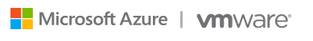
VMware Horizon Cloud on Azure & Azure Virtual Desktop
VMware + Microsoft = Customer Value
Accelerate cloud adoption
Maximize cost savings
Exceptional user experience
Accelerate time to value
Start taking advantage of Microsoft Azure.
Enterprise features
Take full advantage of Azure Virtual Desktop entitlement, features, and pricing.
Platform integrations
Leverage the best of both Azure Virtual Desktop and VMware Horizon, such as FSLogix and Dynamic Environment Manager.
Enable hybrid environments
Leverage existing Horizon on-premises and Azure Virtual Desktop*.
Optimize costs at scale
Advanced power management that matches utilization and saves you money.
Enterprise-class performance
Dynamic remoting protocols deliver near-local desktop and app performance on a broad range of clients.
Common management
Single pane of glass means customers use same tools and skillsets to manage all workloads.
More than just VDI:
Enables broader Windows 10 migration to Azure Virtual Desktop and provides deployment options.
Consistent across all devices
Workspace ONE Access and Intelligent Hub provide secure access to apps and desktops.
Integrates with Active Directory
Horizon Cloud on Microsoft Azure allows customer to use existing Active Directory in addition to Azure Active Directory.
©Microsoft Azure | VMware
* Azure Virtual Desktop entitlements are only available on Microsoft Azure
Notes:
The partnership between Microsoft and VMware is designed to help customers accelerate their cloud adoption while maximizing cost savings and delivering an exceptional user experience.
With this combination of platforms, customers can begin using their Azure Virtual Desktop benefit more quickly by taking advantage of hybrid support and a common management interface across all platforms.
Horizon Cloud on Microsoft Azure has enterprise features that work with the capabilities of Azure Virtual Desktop to optimize costs at scale with advanced power management - a must have as you begin a broader Windows 10 migration to the cloud
And, both Microsoft and VMware are focused heavily on user experience. The combination of FSLogix and VMware Dynamic Environment manager delivers exceptional user environment management capabilities, while the Blast Extreme protocol and Workspace ONE Access provides secure access to apps and desktops.

Slide 24
The right technology for all your needs
Cloud PC – Windows 365
Optimized for simplicity
Cloud VDI – Azure Virtual Desktop
Optimized for flexibility
Windows 10 or Windows 11 personalized desktop
Windows 10, Windows 11, or Windows Server multi-session desktops
Complete end-to-end Microsoft service
Remote app streaming
One-stop administration in Microsoft Endpoint Manager (Enterprise edition)
Full control over configuration
and management
Direct self-service model (Business edition)
Citrix and VMware support
Predictable per user pricing
Flexible consumption-based pricing

Slide 25
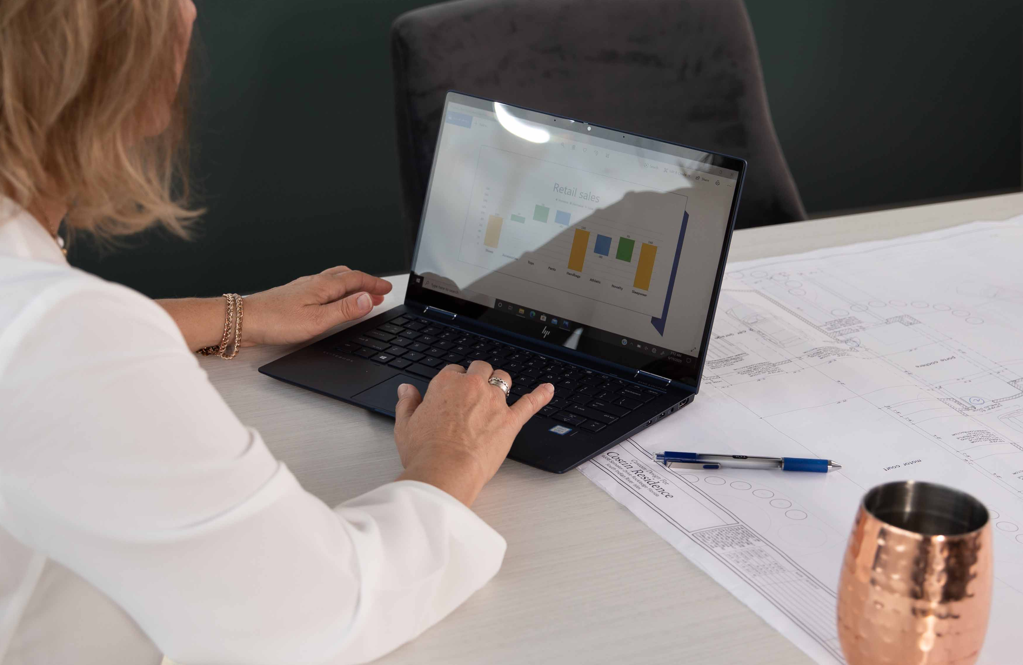


Selecting the right solution(s)
v
Windows 365
Azure Virtual Desktop
Azure Virtual Desktop with Citrix and VMware VDI
Personalized Windows 365 Cloud PCs available across devices.
Simple and turnkey to buy and deploy.
Predictable per user, per month pricing.
Easily scalable compute and storage.
No VDI experience or skills required.
Flexibility and control.
Multi-session Windows VMs.
Data residency and geo requirements.
Remote app streaming.
Specialized GPU and HPC workloads.
Scalable compute and storage to optimize for cost and experience.
Optimize existing investments and skills in Citrix and VMware VDI.
Create a multi-cloud or hybrid architecture with a single control panel.

Slide 26

Taking the next step
Learn more
Start using the service

